Slide 1



PROJECT MANAGEMENT IN PRACTICE
Project Lifecycle & Project Management Process Groups
Lecture No: 2 Week:2
Vispi Shroff
Sub Heading
And Date

Slide 2

Recap
What is a Project?
Constraints in a Project
Project Management
Definition
Difference between Project & Operations

Slide 3
Today’s Topics & Learning Outcomes
Project Lifecycle
Project Phases
Different Approaches
Project Stake Holders
Organizational Culture
Project Management Process Groups
Initiating
Planning
Executing
Monitoring & Controlling
Closing

Slide 4
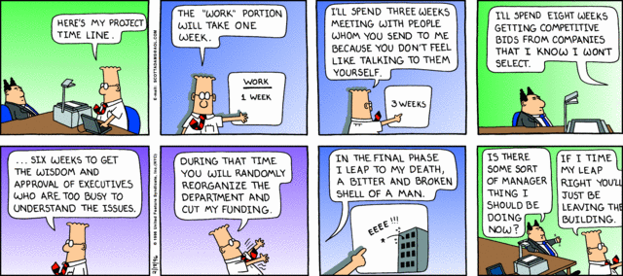
What are the different Project Phases?
February 18, 1996

Slide 5
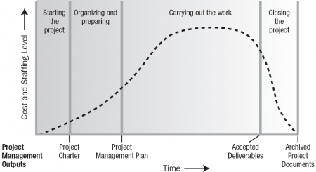
Project Life Cycle
- What about degree of risk & cost of changes over time?

Slide 6
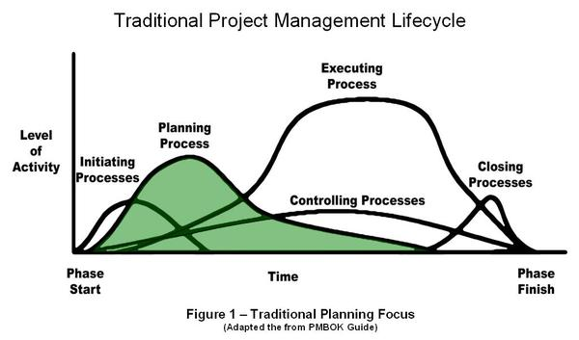
Project Life Cycle

Slide 7
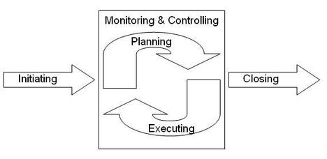

Project Phases
Sequential
Overlapping

Slide 8
Project Management Process Groups
A process is a series of actions directed toward a particular result
Project management can be viewed as a number of interlinked processes
The project management process groups include:
Initiating processes
Planning processes
Executing processes
Monitoring and controlling processes
Closing processes

Slide 9
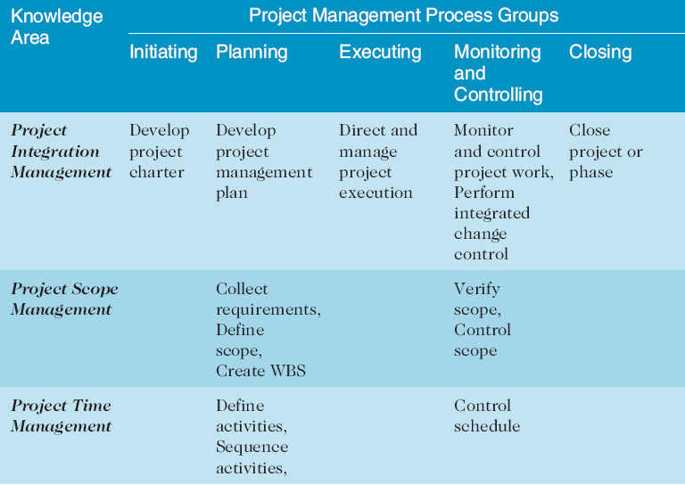
Process Group – Knowledge Area Mapping

Slide 10
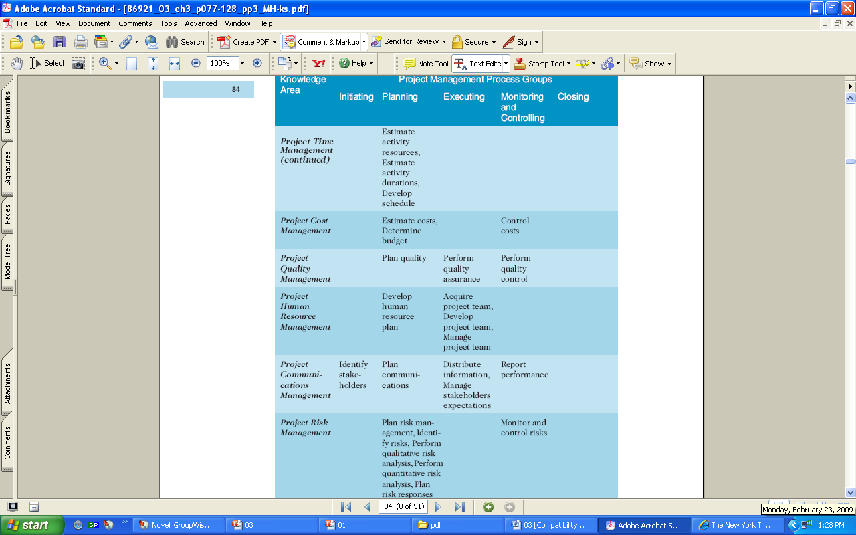
PG-KA Mapping (Continued)

Slide 11
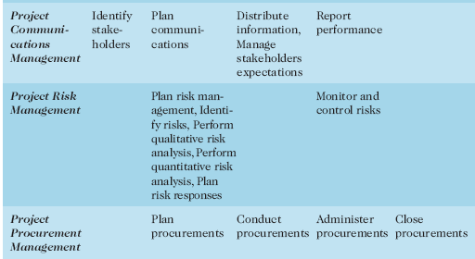
PG-KA Mapping Continued

Slide 12
Activity – If Time Permits…
In groups of 4-5
You have 1 year
You have €100,000
Estimate how much time & money is spent on each of these process groups.

Slide 13
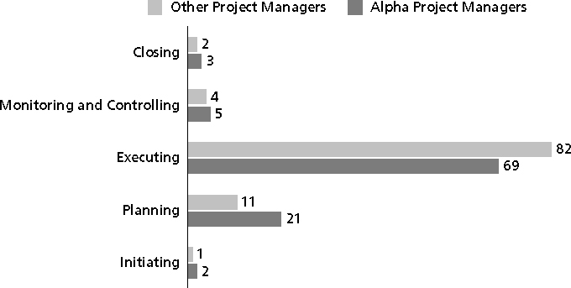
% of Time Spent on Each Process Group
Spot the Difference…?

Slide 14
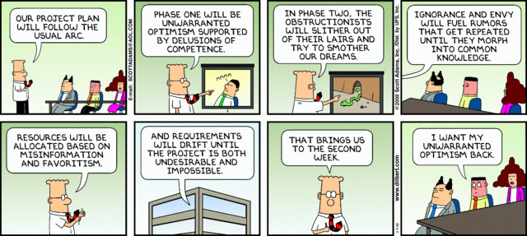
Any Thoughts, Questions, Ideas?
November 9, 2008

Slide 15
Reading Materials for the Week
PMBOK Guide, Chapter 4 & 5
Schwalbe, Information Technology Project Management, Chapter 4 & 5

Slide 16
Conclusions
Project Life Cycle
Different Project Phases
Different Process Groups
Process Group to Knowledge Area Mapping
NEXT TIME
- Project Integration Management

Slide 17
References
PMBOK Guide – Chapters 2 & 3
Schwalbe, K. – Information Technology Project Management – Chapters 3
Dilbert Comics, www.dilbert.com

